Slide 1
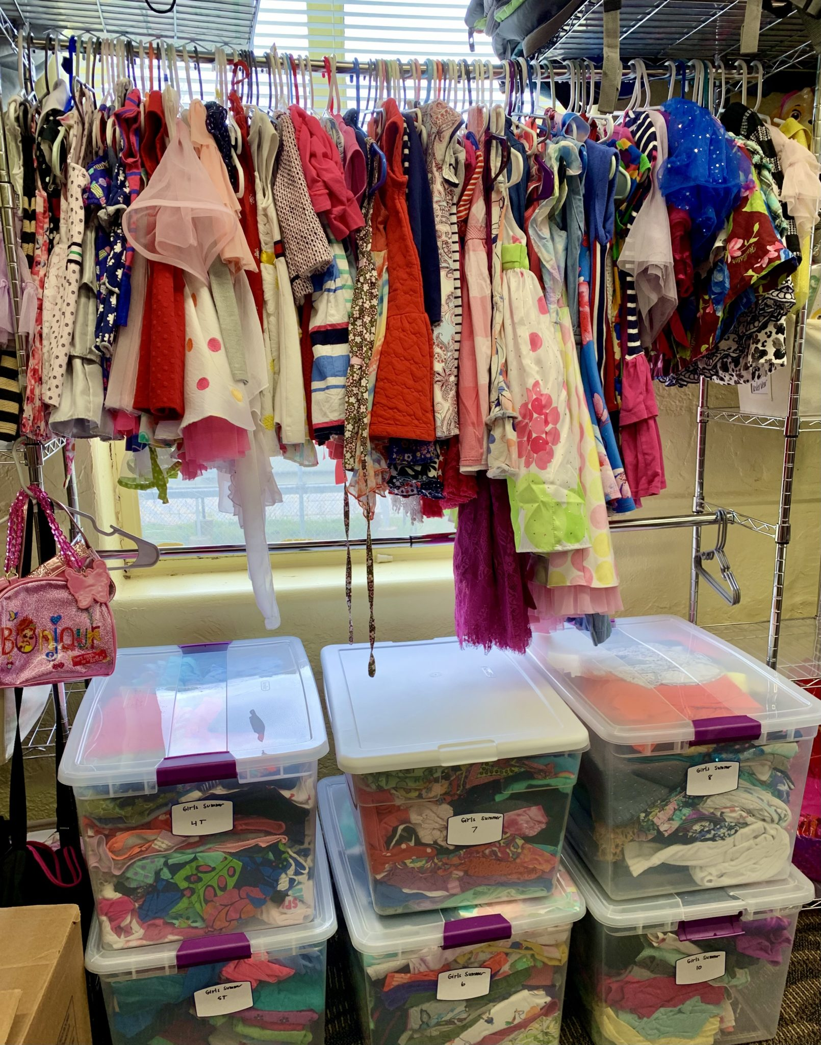
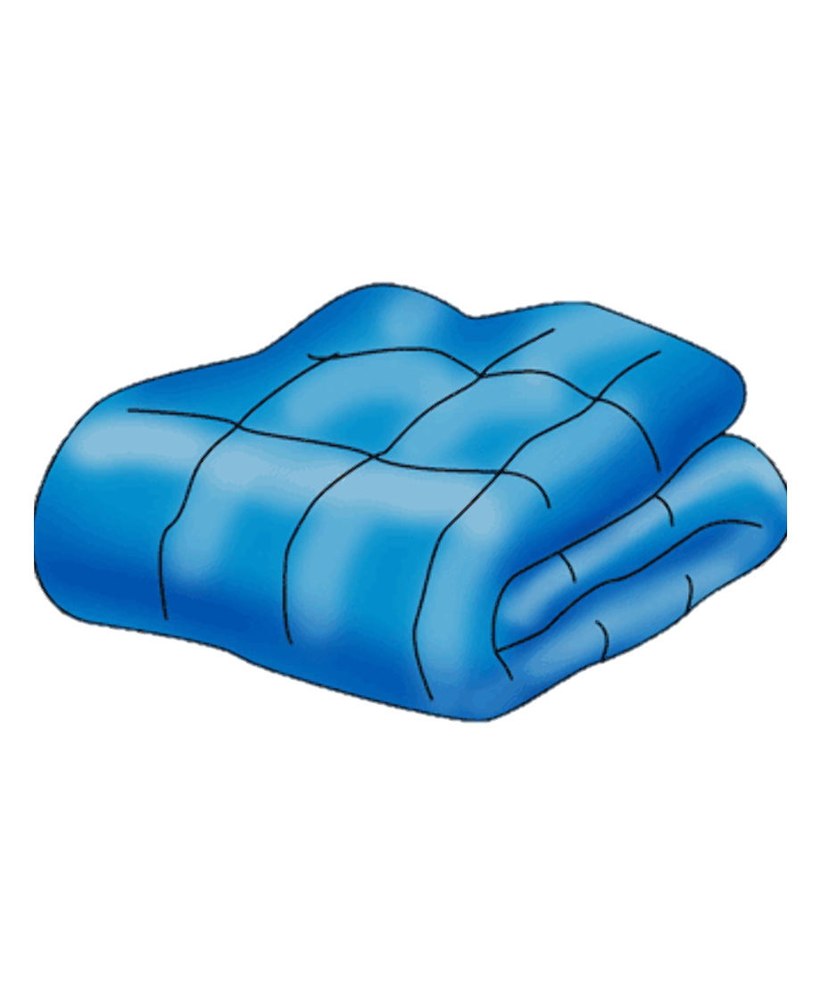
Agency project
care closet
Psrc - Indian education resource center
Rachel Locklear

Slide 2
What is the care closet
CARE
CLOSET
A room in the indian education resource center filled with many necessities for student needs, such as; clothing, coats, shoes, socks, underwear, school supplies, non-perishable items, etc.

Slide 3
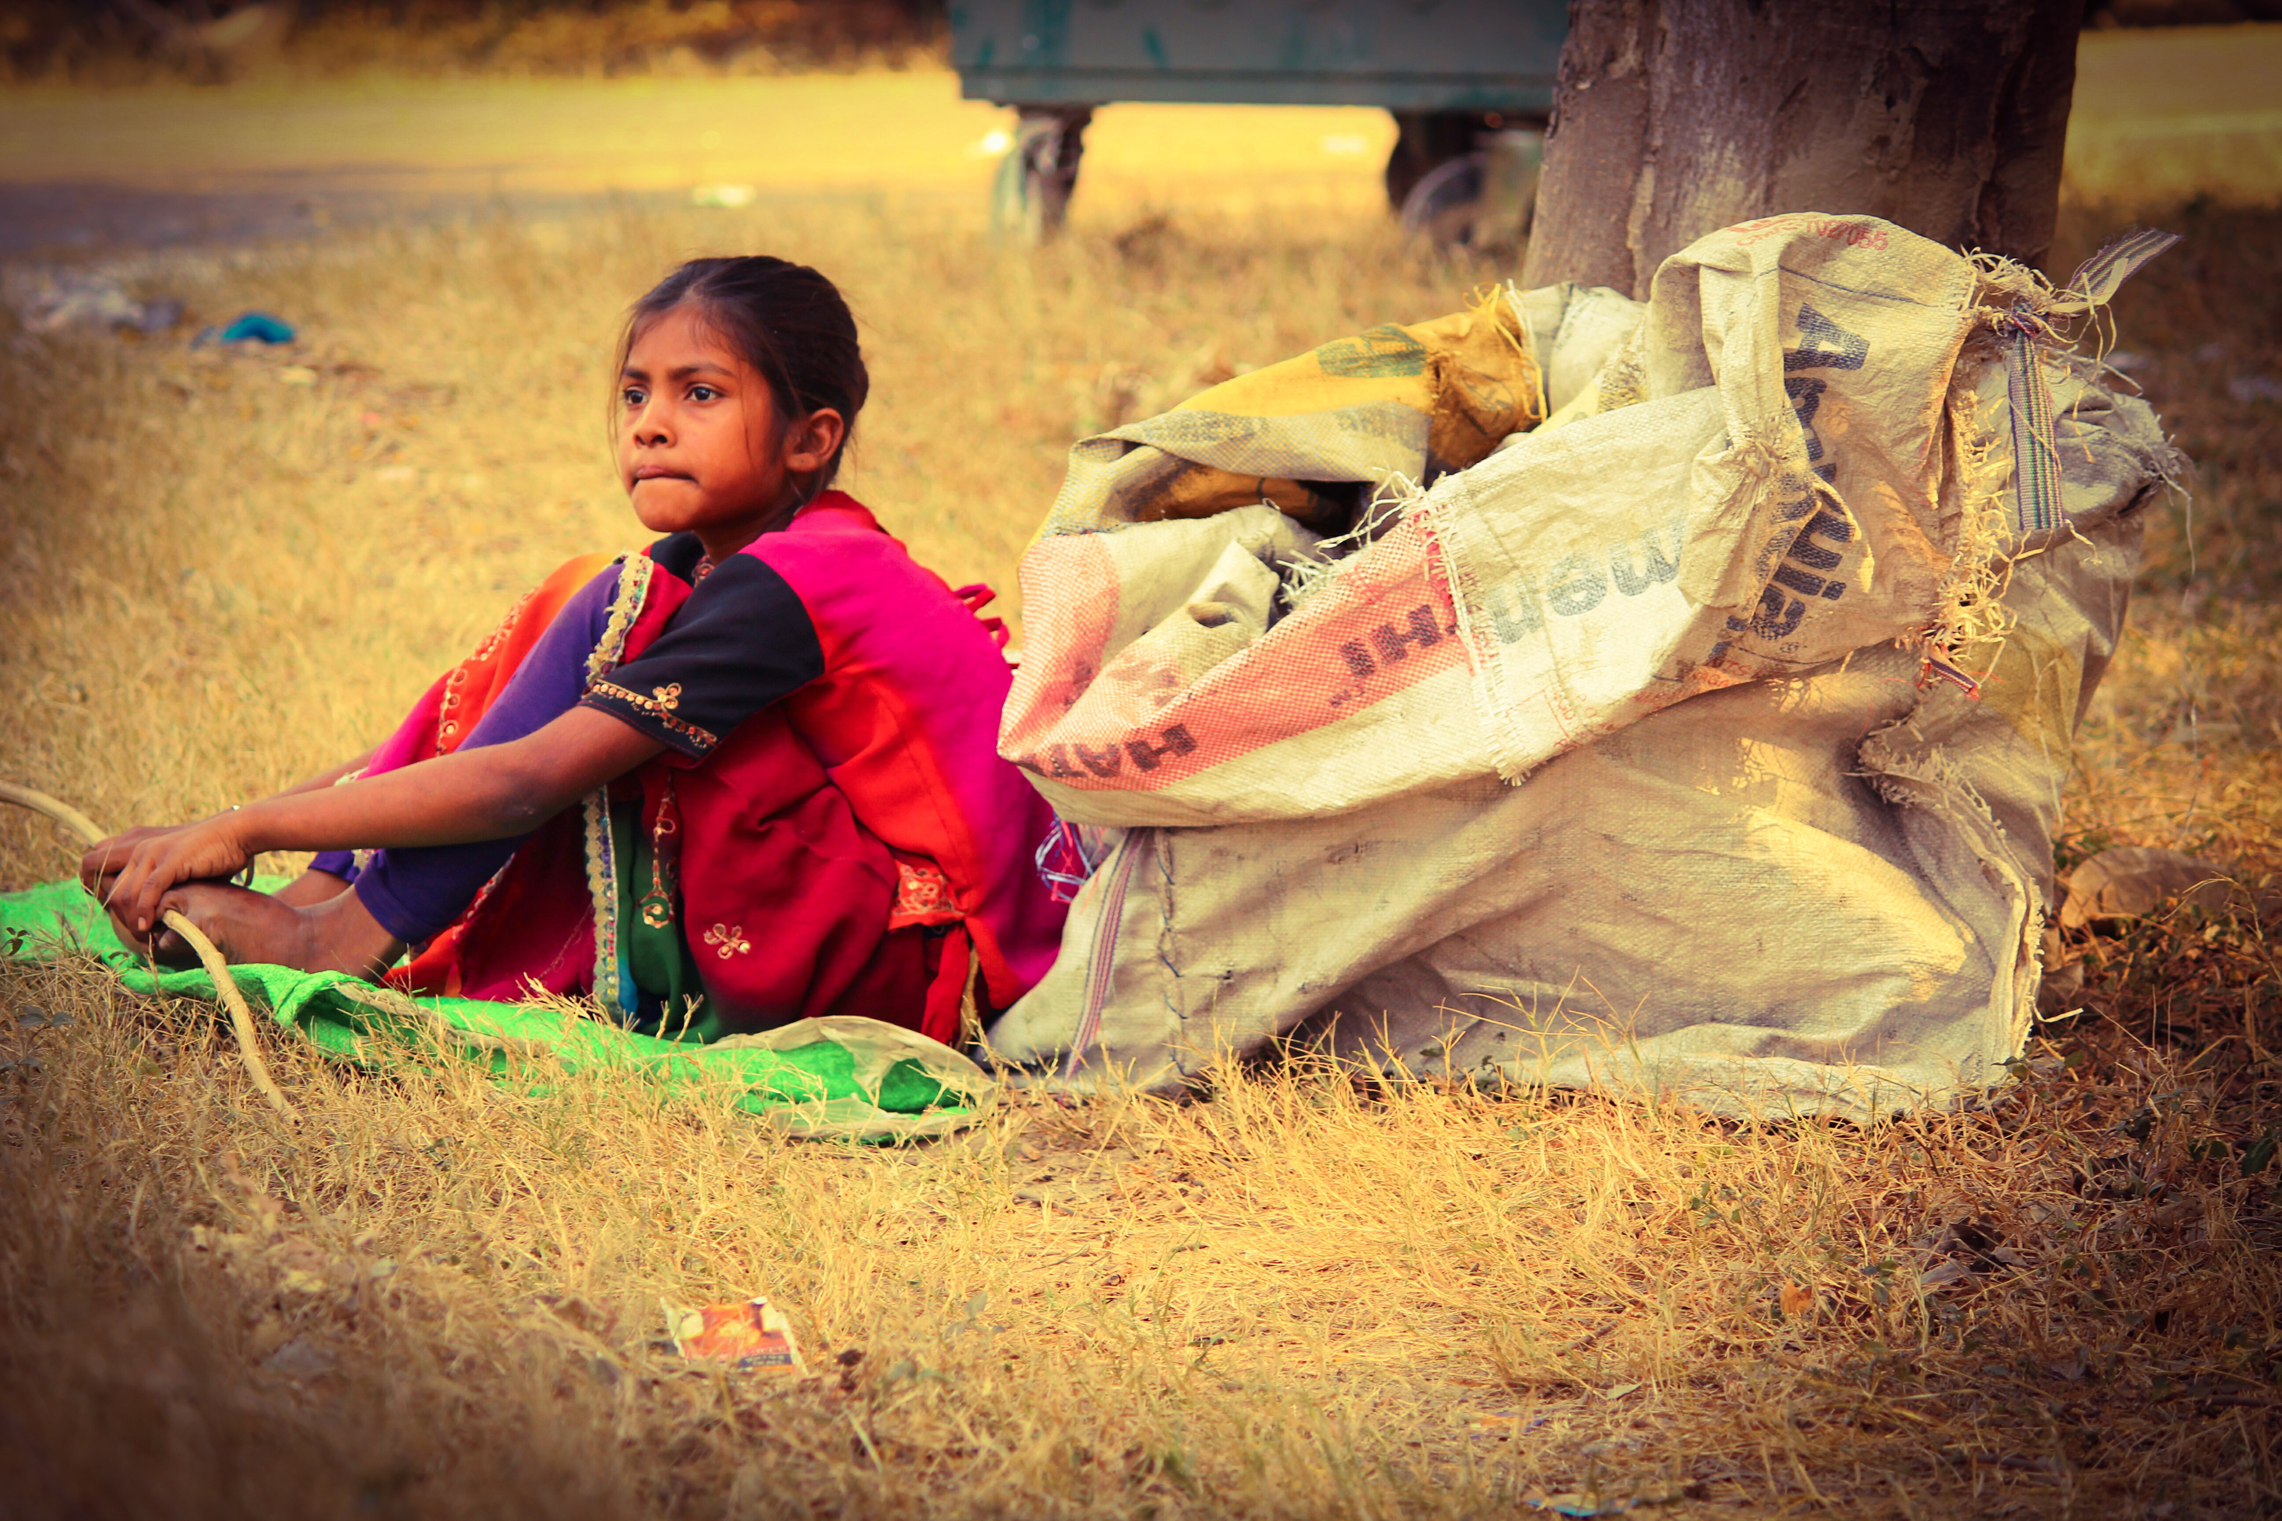
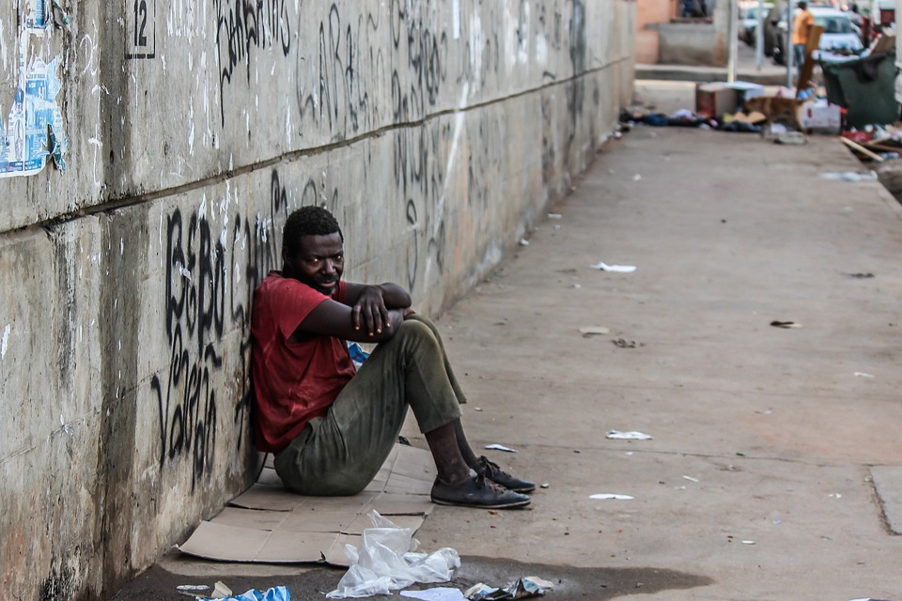
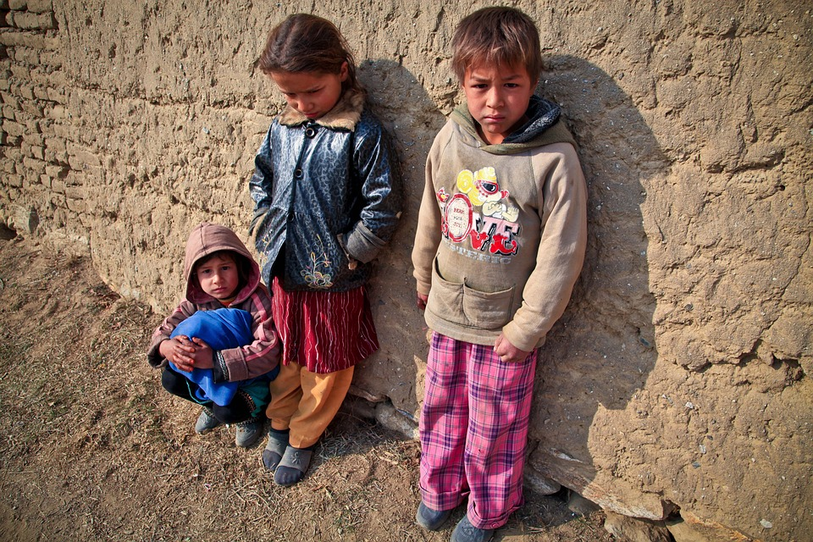
why?
Robeson county has one of the highest poverty rates in the state
Many students come to school on cold days without coats, socks, or warm and clean clothing
Student’s shoes may be too small/too big
Family may be in need of items in the care closet
Youth development specialists and school social workers know the specific needs of students and can identify students in need.

Slide 4
Who?
Youth development specialists and school social workers will collaborate to identify students in need
A student may come to school needing a coat or a pair of socks
Any/all School students in need will be able to benefit from the care closet
Also, anyone in the community will be able to donate/contribute to the care closet

Slide 5
Where?
The care closet will be located in a storage room at the indian education resource center

Slide 6
How?
Youth development specialists and school social workers will collaborate to identify students in need
Any time a student has a dire/emergent need, the staff is able to come to the care closet to pick up any items needed.
A lot will be kept to document the needs met for each community

Slide 7
donations
Anyone in the community is able to donate to the care closet
If a student has a need and we do not have it in the care closet, we will reach out to local resources to supply the need.

